Slide 1
UNIT I
Financial Management

Slide 2
Course Outcomes
Analyse the role of finance manager in contemporary scenario.
Analyse the objective of finance.

Slide 3
Role of Finance Manager
Raising of Funds
Allocation of Funds
Profit Planning
Understanding Capital Markets

Slide 4
Funds Raising
The traditional approach dominated the scope of financial management and limited the role of the financial manager simply to funds raising. It was during the major events, such as promotion, reorganization, expansion or diversification in the firm that the financial manager was called upon to raise funds.
In the day-to-day activities, finance manager was to see that the firm had enough cash to meet its obligations. The traditional approach has been criticized because it failed to consider the day-to-day managerial problems relating to finance of the firm.

Slide 5
Funds Allocation
In a modern enterprise, the basic finance function is to decide about the expenditure decisions and to determine the demand for capital for these expenditures or concerned with the efficient allocation of funds. The financial manager must find a rationale for answering the following three questions:
How large should an enterprise be, and how fast should it grow?
In what form should it hold its assets?
How should the funds required be raised?

Slide 6
MCQ
Corporate governance success includes three key groups. Which of the following represents these three groups?
Suppliers, managers, and customers.
Board of Directors, executive officers, and common shareholders.
Suppliers, employees, and customers.
Common shareholders, managers, and employees.

Slide 7
B. Board of Directors, executive officers, and common shareholders.

Slide 8
Profit Planning
Profit planning refers to the operating decisions in the areas of pricing, costs, volume of output and the firm’s selection of product lines. Profit planning is, therefore, a prerequisite for optimizing investment and financing decisions.
The cost structure of the firm, i.e., the mix of fixed and variable costs has a significant influence on a firm’s profitability.

Slide 9
Understanding Capital Markets
Capital markets bring investors (lenders) and firms (borrowers) together. Hence the financial manager has to deal with capital markets and fully understand the operations of capital markets and the way in which the capital markets value securities. He or she should also know how risk is measured and how to cope with it in investment and financing decisions.
For example, if a firm uses excessive debt to finance its growth, investors may perceive it as risky. The value of the firm’s share may, therefore, decline.

Slide 10
MCQ
Que. In his traditional role the finance manager is responsible for…………….
Proper utilization of funds
Arrangement of financial resources
Acquiring capital assets of the organization
Efficient management of capital

Slide 11
Answer: Option B
In his traditional role the finance manager is responsible for arrangement of financial resources. Financial managers are responsible for the financial health of an organization. They produce financial reports, direct investment activities, and develop strategies and plans for the long-term financial goals of their organization.

Slide 12
Risk-return Trade-off
Financial decisions incur different degree of risk and decision to invest money in government bonds has less risk as interest rate is known and the risk of default is very less.
On the contrary, more risk in security investment as return is not certain. However, you can expect a lower return from government bond and higher from shares. Risk and expected return move in tandem; the greater the risk, the greater the expected return. Financial decisions of the firm are guided by the risk-return trade-off.

Slide 13
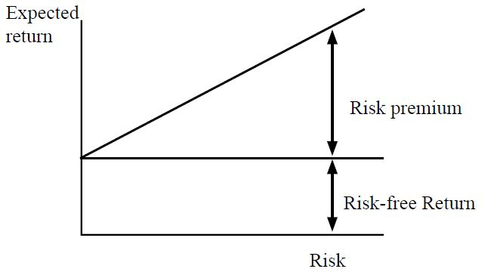
Contd……

Slide 14
MCQ
Que. most of investors are risk averse which means……………..
They will assume more risk only if they are compensated with higher expected return.
They will always invest in the investment with lowest possible risk.
They will always invest in the investment with highest possible risk.
They avoid the stock market due to higher risk.

Slide 15
Answer
Option D
Most investors are risk averse which means they avoid the stock market due to the high degree of risk. A risk-averse investor, on the other hand, dislikes risk and, thus, stays away from high-risk stocks or investments and is prepared to forego higher rates of return.

Slide 16
Objectives of Financial Management
To ensure regular and adequate supply of funds to the concern.
To ensure adequate returns to the shareholders.
To ensure optimum funds utilization.
To ensure safety on investment.
To plan a sound capital structure.

Slide 17
MCQ
The long-run objective of financial management is to:
a) maximize earnings per share.
b) maximize the value of the firm's common stock.
c) maximize return on investment.
d) maximize market share.

Slide 18
Answer
b) maximize the value of the firm's common stock.

